Slide 1


REAL TIME PROJECT
Department of CSE (Data Science)
Presented by
1. P. NARESH(22891A67B0)
2. P. VISHNU TEJA (22891A67B2)
3. J. BHAGATH(22891A6784)
Under the Guidance of:
Ms.BHULAKSHMI MADAM

Slide 2

Construction||real estate website

Slide 3
Abstract
Our construction and real estate website aims to provide a comprehensive platform for users to explore various properties, construction projects, and real estate services. Through intuitive design and interactive features, users can seamlessly navigate the site to find their dream home, invest in lucrative projects, or avail themselves of professional services
This project aims to design and develop a modern, responsive, and interactive website for a construction company or real estate agency using HTML, CSS, and JavaScript. The website will showcase the company's projects, services, and properties, providing an engaging user experience for potential clients and customers.A gallery or portfolio section to display completed projects, including images, descriptions, and details.a searchable database of available properties, including filters, sorting, and pagination.asection highlighting the company's services, such as construction, renovation, and property management.a section providing information about the company's history, mission, and team members.a contact form with validation and submission functionality.JavaScript-powered interactive elements, such as animations, scrolling effects, and hover effects. search bar with autocomplete suggestions and filtering capabilities.a section for publishing news, articles, and updates about the company and industry

Slide 4
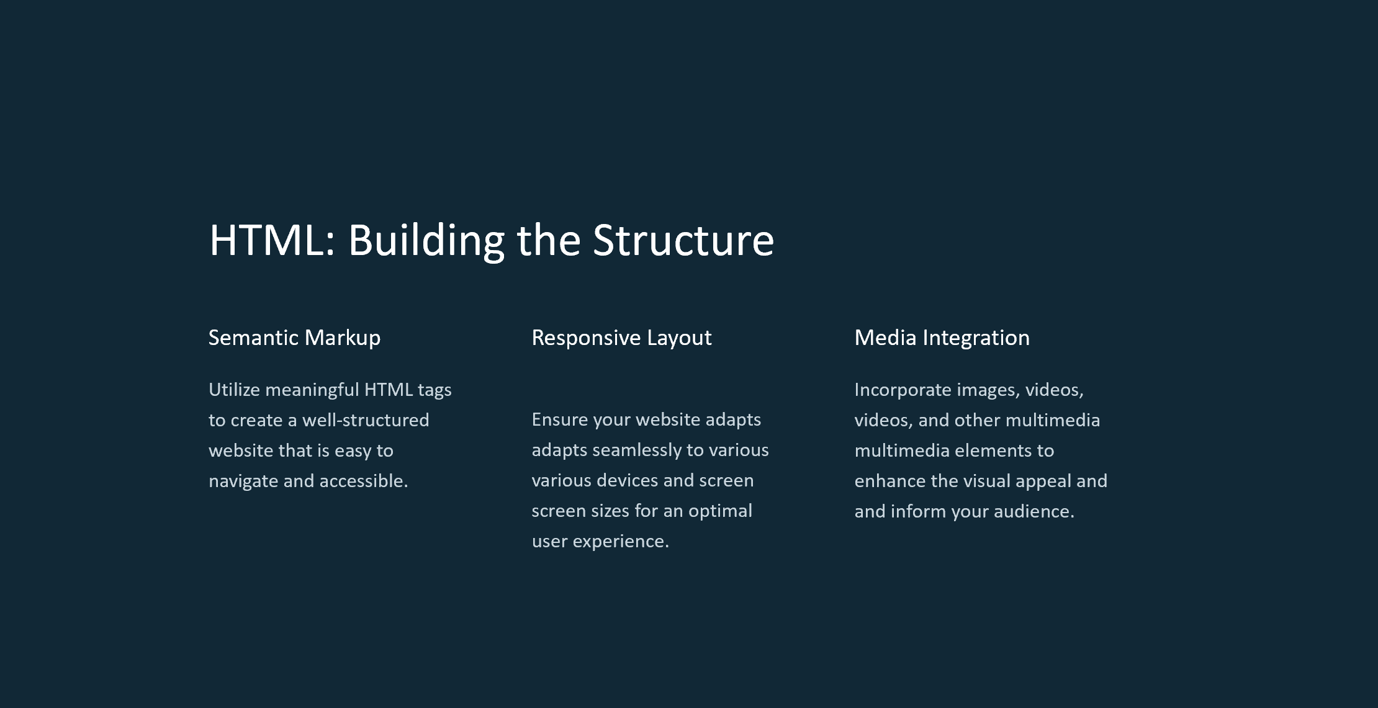

Slide 5
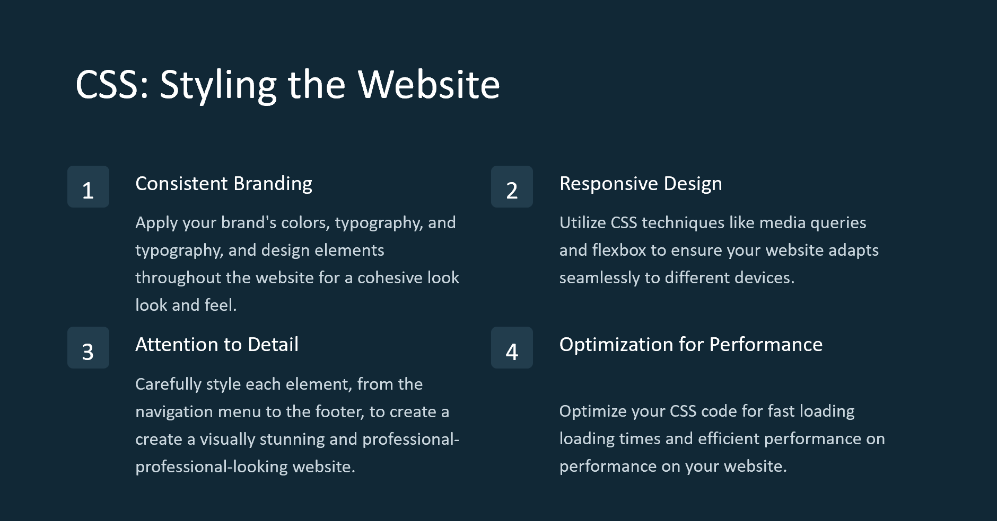

Slide 6
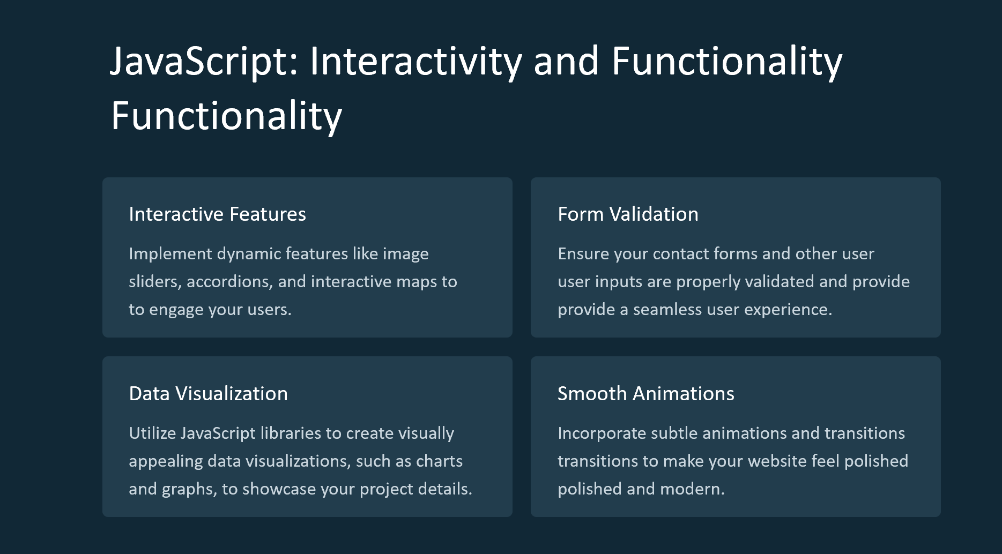

Slide 7
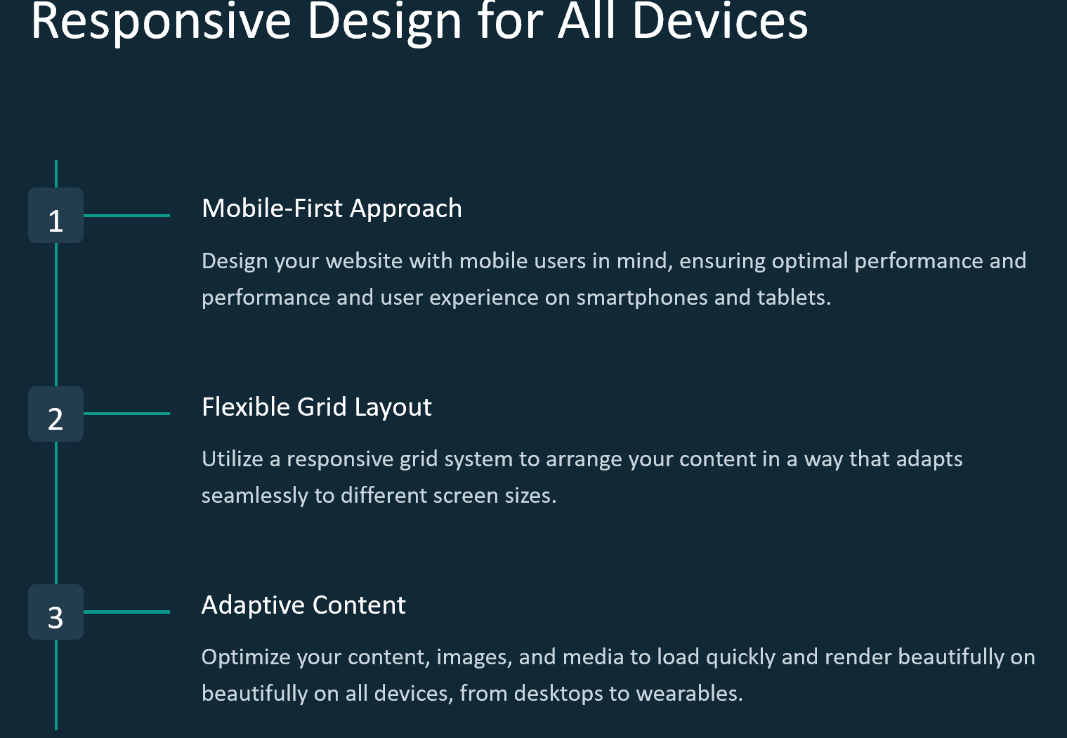

Slide 8
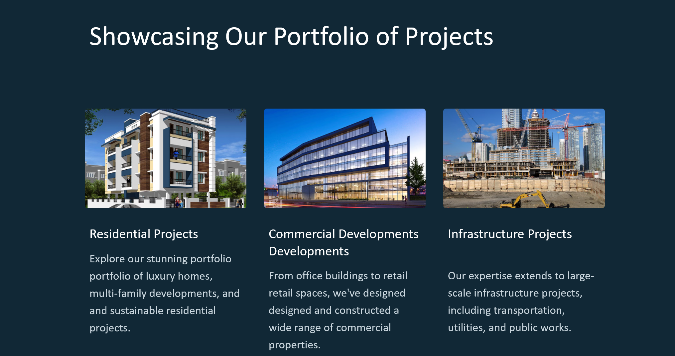

Slide 9
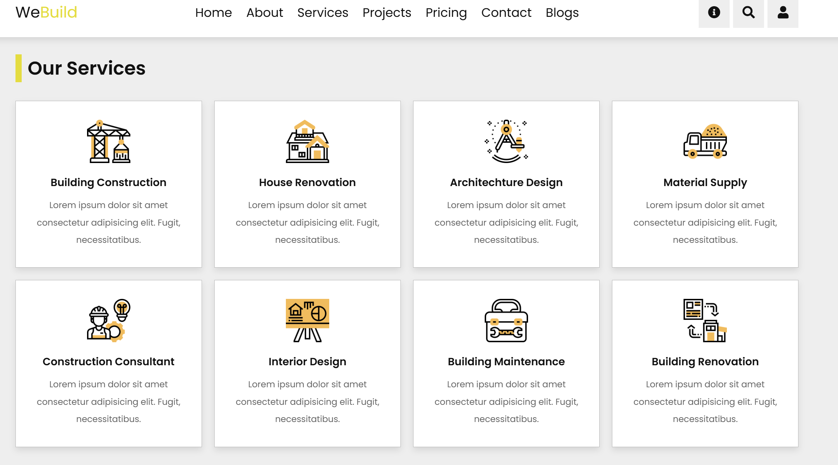

Slide 10
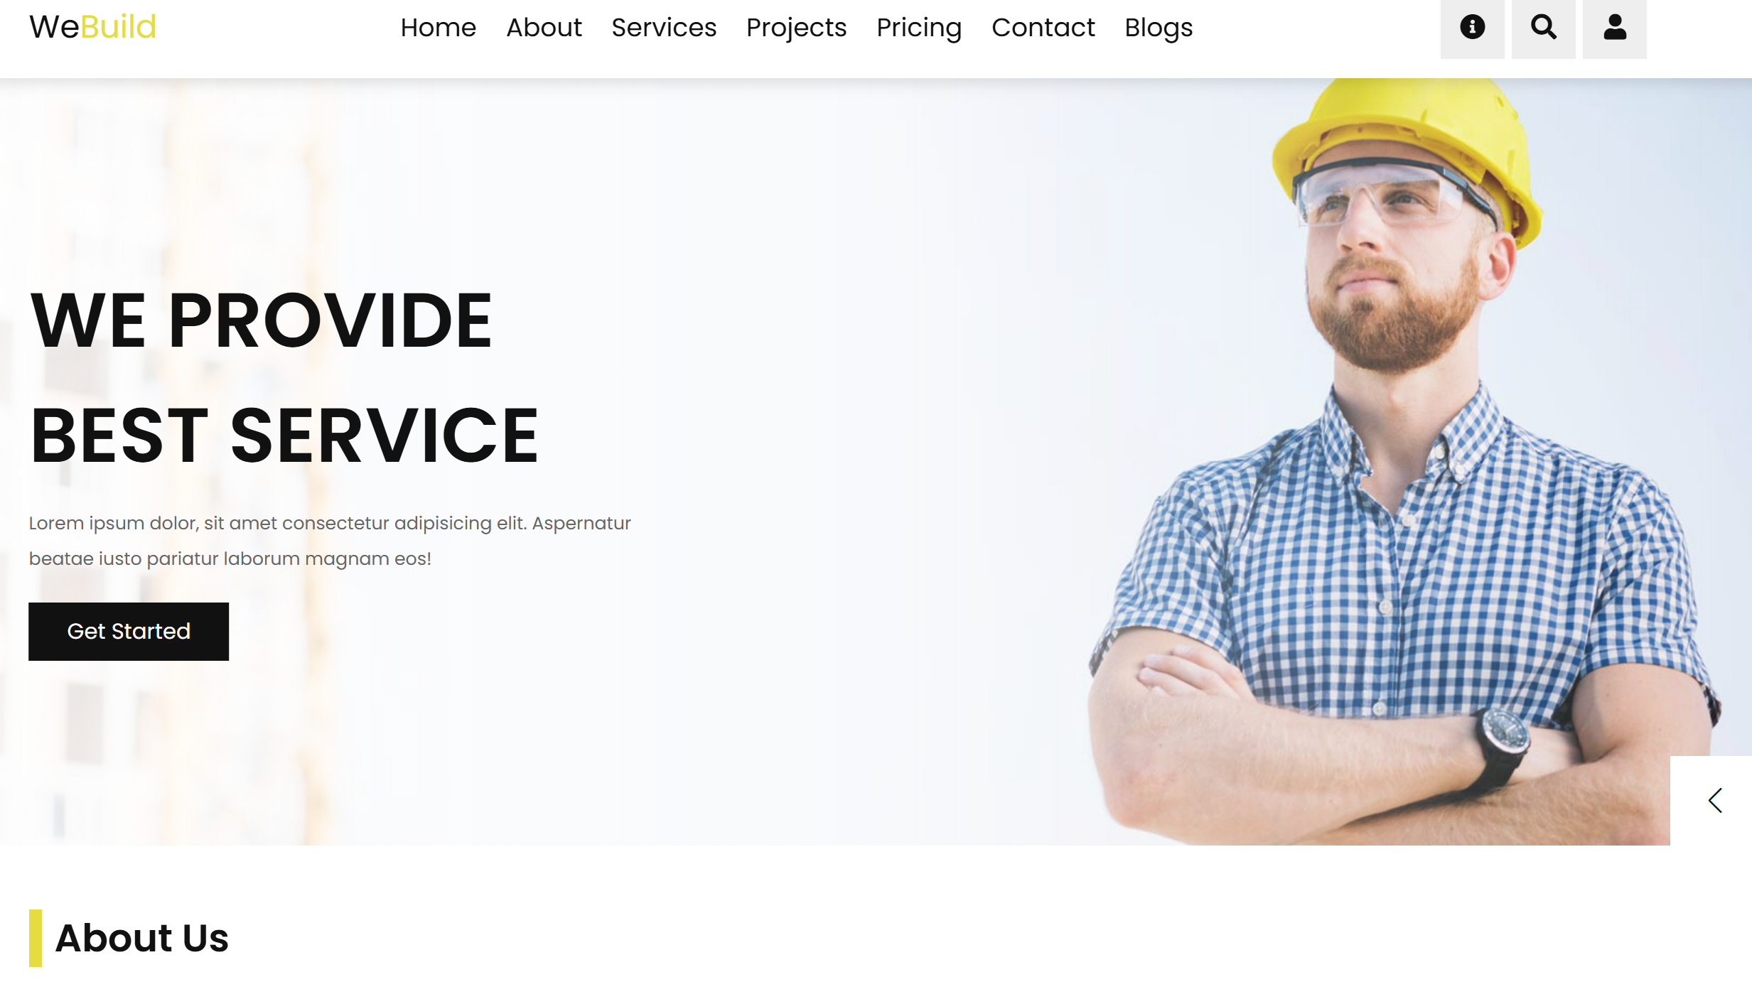

Slide 11
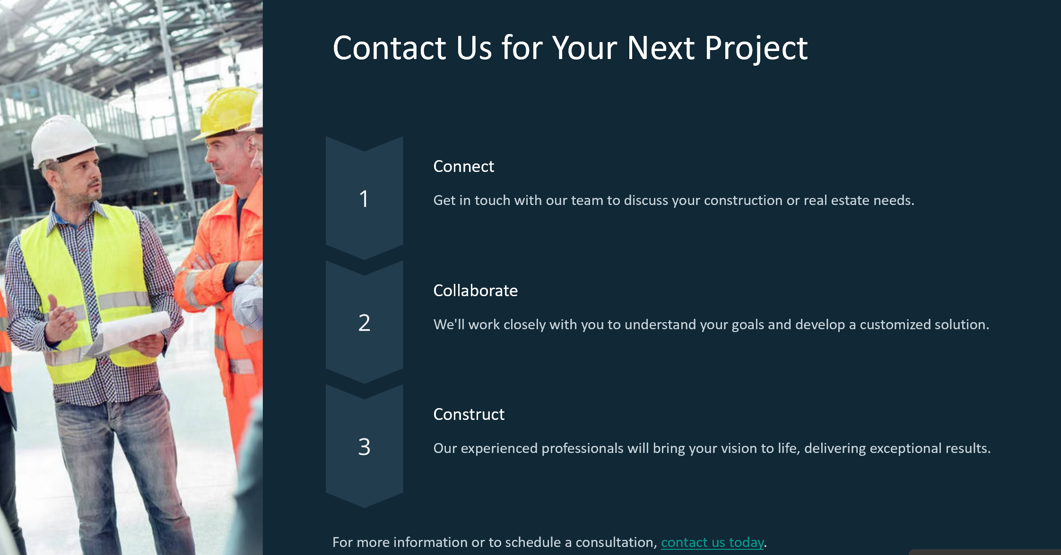

Slide 12



